Slide 1
Vehicle Insurance

Slide 2
What is Vehicle Insurance?
Vehicle insurance is insurance for cars, trucks, motorcycles, and other road vehicles. Its primary use is to provide financial protection against physical damage or bodily injury resulting from traffic collisions and against liability that could also arise from incidents in a vehicle.

Slide 3
Type of Vehicle Insurance
Car Insurance.
Two Wheeler/Bike Insurance.
Commercial Vehicle Insurance.
Taxi/Cab Insurance.
Auto Rickshaw Insurance.
Truck Insurance.
Health Insurance.
Super Top-up Health Insurance.
and many more

Slide 4
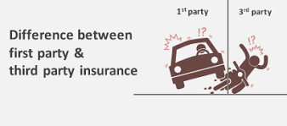
Vehicle Insurance Plan
Vehicle Insurance are taken for
1st Party Insurance
3rd Party Insurance

Slide 5
Project Vehicle Insurance Table
Login
Customer
Agent
Policy
Vehicle

Slide 6
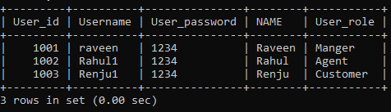
Login Table

Slide 7
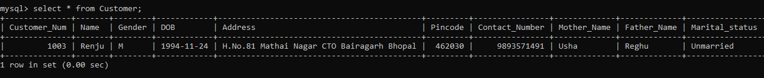
Customer Table

Slide 8
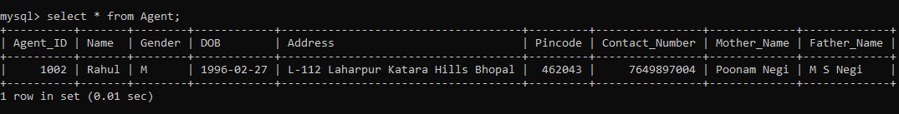
Agent Table

Slide 9
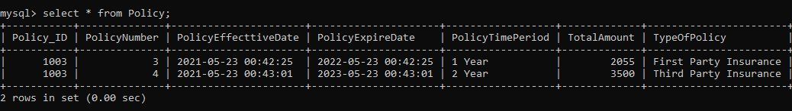
Policy Table

Slide 10
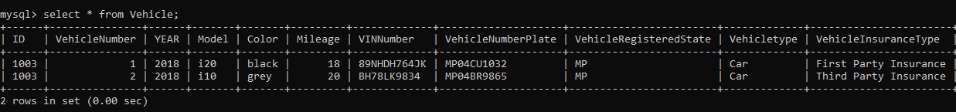
Vehicle Table

Slide 11
Thank You

